Slide 1
Does data interpolation contradict statistical optimality? Mikhail Belkin, Alexander Rakhlin, Alexandre B. Tsybakov
Presented by: Omar Mezghani
20. March 2024

Slide 2
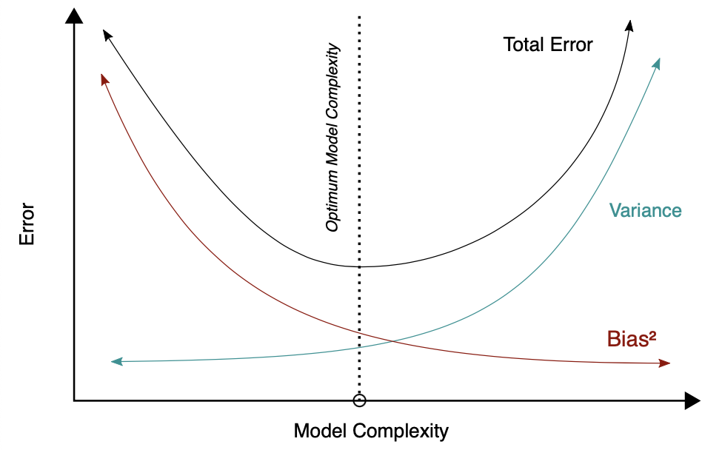
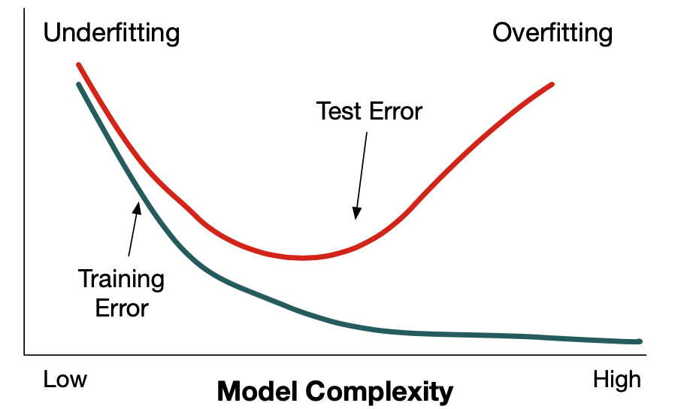
Traditional beliefs about overfitting and model complexity
^{[1]}
^{[2]}
[1] Belkin, M., Rakhlin, A., & Tsybakov, A. B. (2019, April). Does data interpolation contradict statistical optimality?. In The 22nd International Conference on Artificial Intelligence and Statistics(pp. 1611-1619). PMLR.
[2] By Bigbossfarin - Own work, CC0, https://commons.wikimedia.org/w/index.php?curid=105307219

Slide 3
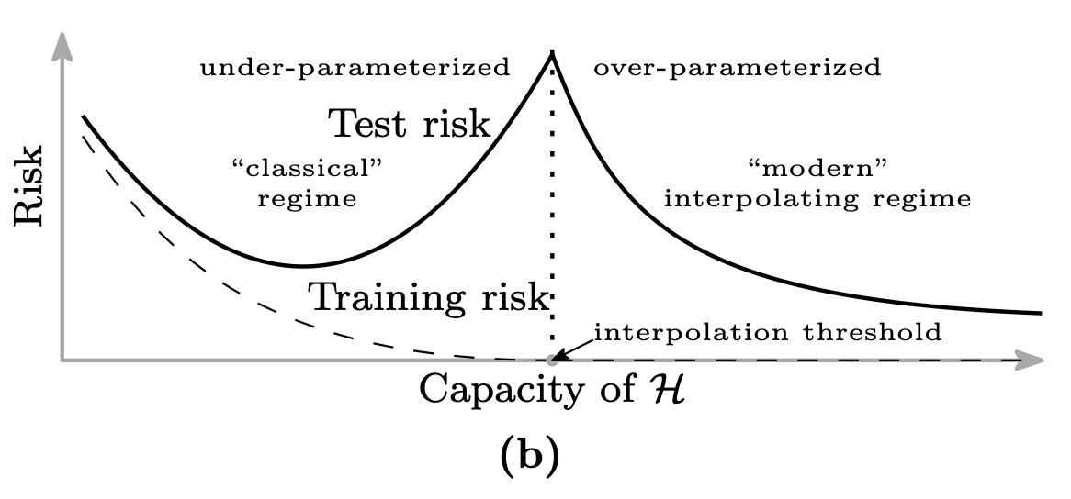
Rethinking Interpolation in Machine Learning
underparametrized regime: less parameters than data leads to an approximation. We observe the typical bias-variance trade-off.
overparametrized regime: more parameters than data yields an underspecified problem with many interpolating solutions.
^{[1]}
[1] Belkin, M., Hsu, D., Ma, S., & Mandal, S. (2019). Reconciling modern machine-learning practice and the classical bias–variance trade-off. Proceedings of the National Academy of Sciences, 116(32), 15849-15854.

Slide 4
What is Nonparametric Regression?
An estimator of f is a function:
$$x → f_{n}( x )=f_{n}( x, X_{1} ,…, X_{n})$$
If $f∈\{ g ( x, θ ): θ ∈ Θ \}$, where $Θ ⊆ℝ^{k}$, then this is a parametric problem of estimation.
On the contrary, in nonparametric estimation it is usually assumed that f belongs to some “massive” class F of densities
^{[1]}
[1] https://www.colorado.edu/lab/lisa/services/short-courses/parametric-versus-seminonparametric-regression-models

Slide 5
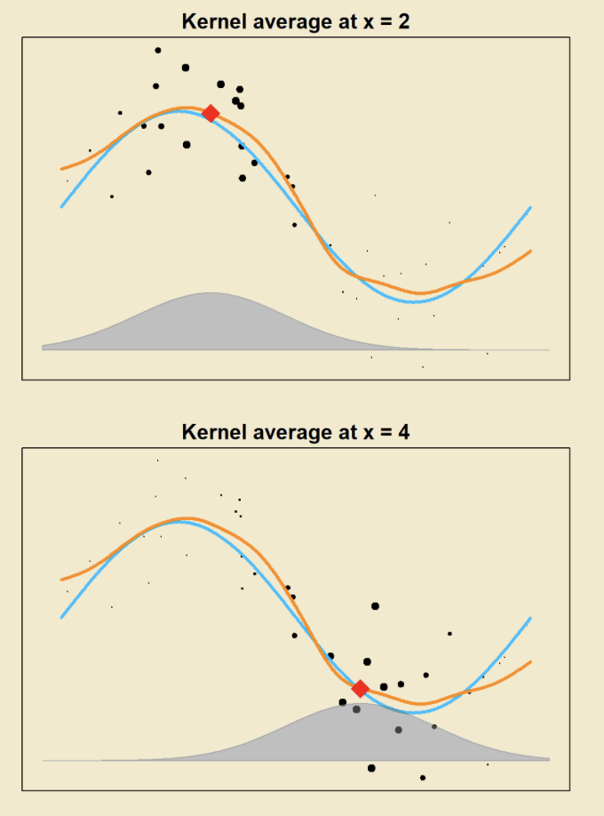
Nadaraya-Watson estimator
^{[1]}
Nadaraya–Watson kernel regression:
$f_{n}\left(x\right)=\frac{\sum_{i=1}^{n}{Y_{i}K\left(\frac{x−X_{i}}{h}\right)}}{\sum_{i=1}^{n}{K\left(\frac{x−X_{i}}{h}\right)}}$
Where K: $ℝ^{d}→ℝ$is a kernel function and $h>0$ is a bandwidth, and we assume that the denominator does not vanish.
[1] https://teazrq.github.io/SMLR/kernel-smoothing.html

Slide 6
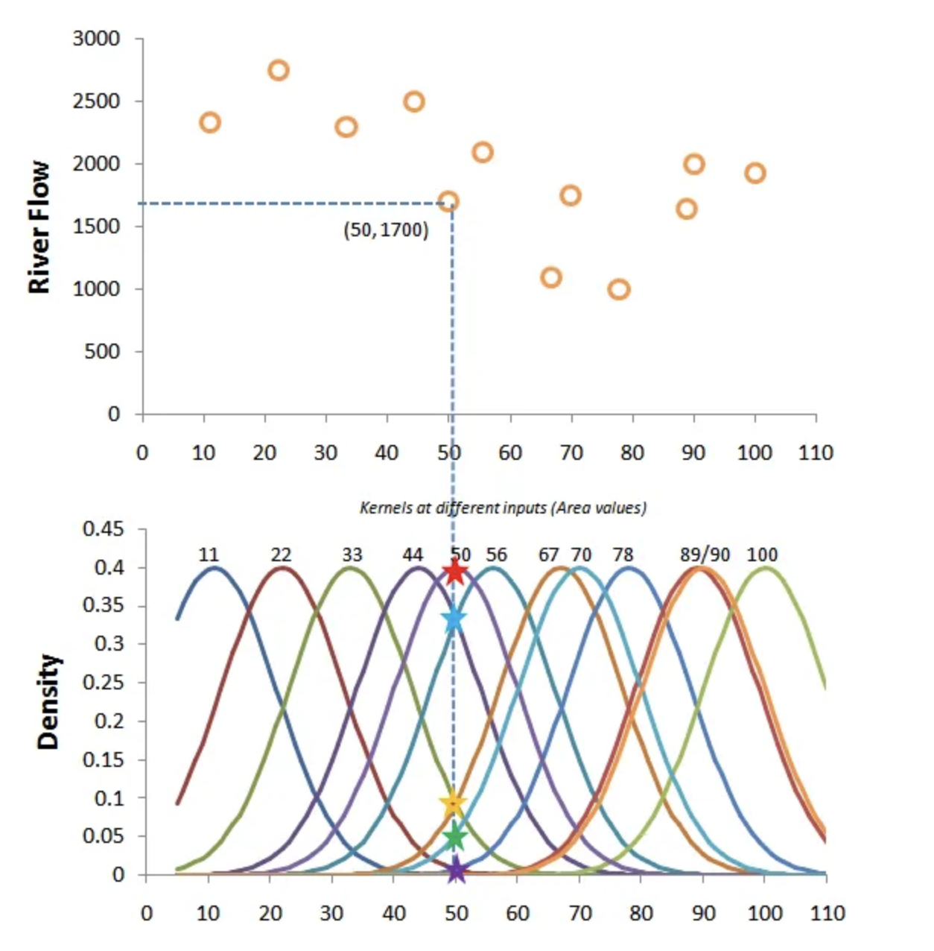
Example
^{[1]}
Using the gaussian kernel:
$$k\left(x\right)=\frac{1}{\sqrt{2π}}\exp\left(−\frac{x^{2}}{2}\right)$$
The kernel values are scaled between 0 and 1 to use them as weights.
$$w_{i}=\frac{k_{i}}{\sum_{j=1}^{n}{k_{j}}}$$
Therefore,
$$f_{n}\left(x\right)=\sum_{i=1}^{n}{Y_{i}w_{i}}$$
[1] https://towardsdatascience.com/kernel-regression-made-easy-to-understand-86caf2d2b844

Slide 7
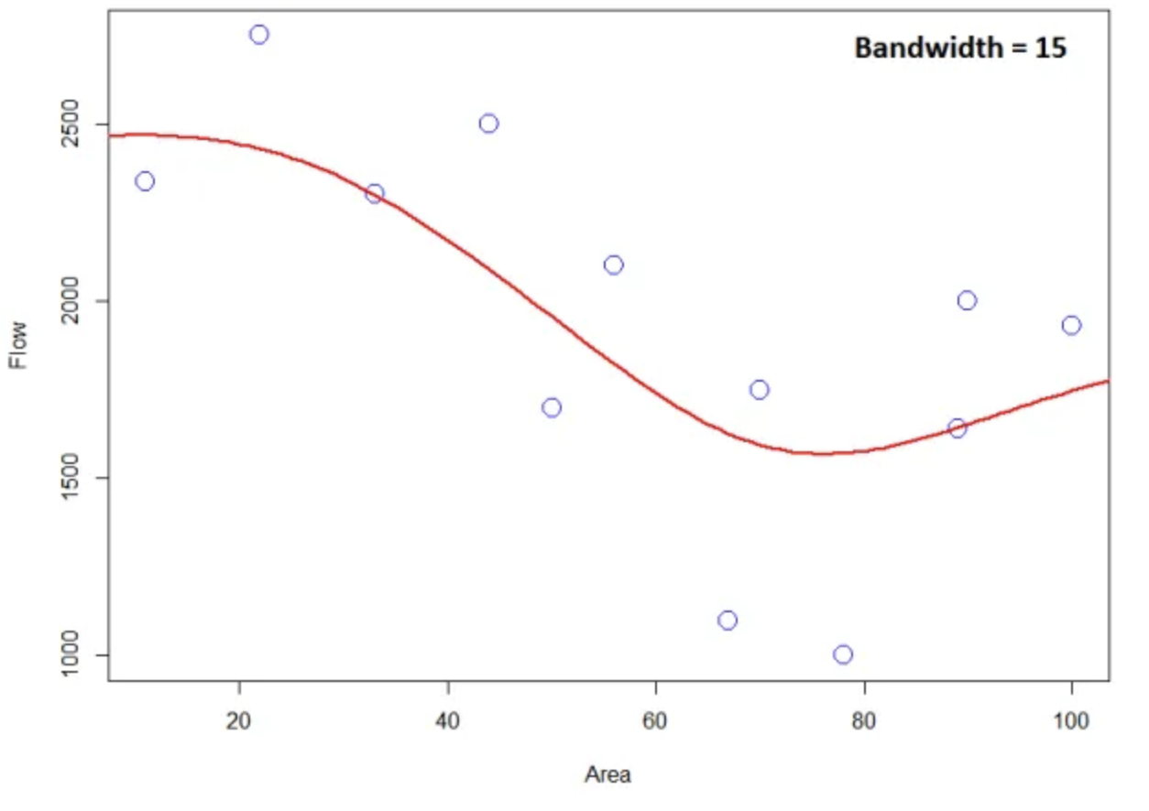
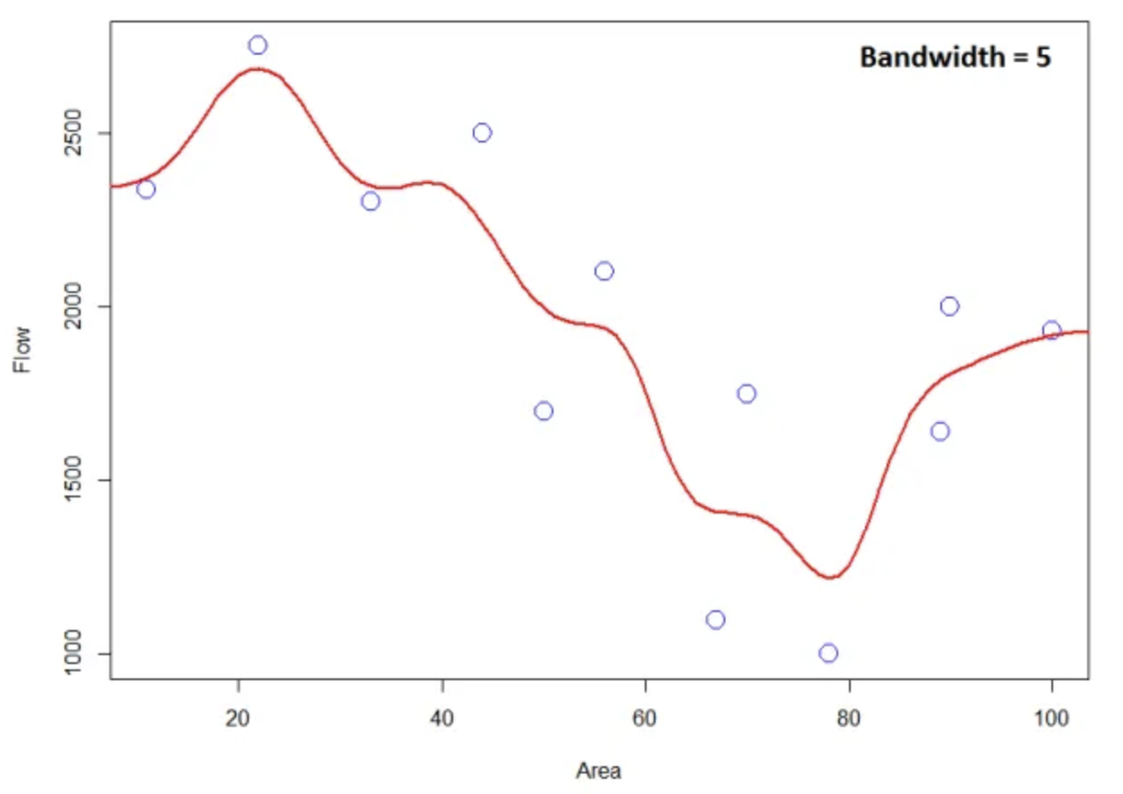
Bandwidth Sensitivity
^{[1]}
[1] https://towardsdatascience.com/kernel-regression-made-easy-to-understand-86caf2d2b844

Slide 8
Hölder class
For $L>0$ and $β∈\left]0,2\right]$, the $\left(β,L\right)$- Hölder class, denoted by$Σ\left(β,L\right)$, is defined as follows:
If $β∈\left]0,1\right]$, the class $Σ\left(β,L\right)$consists of functions f : $ℝ^{d}→ℝ$satisfying
$∀ x,y ∈ℝd, |f(x)−f(y)| ≤ L ∥x−y∥β$
If $β∈\left]1,2\right]$, the class $Σ\left(β,L\right)$consists of continuously differentiable functions f : $ℝ^{d}→ℝ$satisfying for all $x, y ∈ ℝd$
$|f (x) − f (y) − ⟨∇f (y), x − y⟩ | ≤ L ∥x − y∥β$
where $⟨·, ·⟩$denotes the inner product.

Slide 9
kernel of order$ℓ$
Let $ℓ≥ 1$ be an integer. We say that $K:ℝ⟶ℝ$is a kernel of order $ℓ$ if the functions $u → u^{j} k( u )$, j =0, 1,..., $ℓ$, are integrable and satisfy
$\int{K ( u ) du}=1$, $\int{u^{j}k( u )}du =0 , j =1 ,…,$ $ℓ$

Slide 10
Tsybakov statistical optimality theorem
Assume that $f∈Σ\left(β,L\right)$and let $K:ℝ⟶ℝ$ be a kernel function of order $ℓ=\left\lfloor β\right\rfloor$ such that
$\int{k^{2} ( u ) du}< ∞$ and $\int{{| u |}^{β} | K ( u ) | du}< ∞ .$ Fix $α> 0$ and take $h = αn^{\frac{−1}{2 β +1}}$. Then for $n ≥ 1$the estimator $f_{n}$satisfies
$$\sup_{x_{0}∈ℝ}{\sup_{f∈Σ\left(β,L\right)}{𝔼}}\left[{\left(f_{n}\left(x_{0}\right)−f \left(x_{0}\right)\right)}^{2} \right]≤Cn^{\frac{− 2 β}{2 β +1}} ,$$
where $C> 0$ is a constant depending only on $β, L, α$and on the kernel K.
The kernels are “non-singular”.
There is no interpolation.

Slide 11
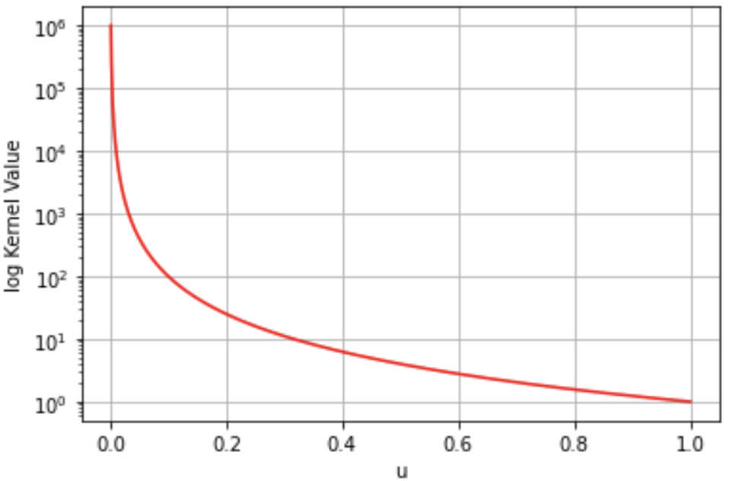
Dive into Singular Kernels
$K (u)={∥u∥}^{−a}Ι\{∥u∥ ≤ 1\}$, for some $a > 0$. Here, $∥·∥$ denotes the Euclidean norm
$K (u)={∥u∥}^{−a}{\left[1−∥u∥\right]}_{+}^{2}$, where ${[c]}_{+} = max⁡\{c, 0\}$
$K \left(u\right)={∥u∥}^{−a} \cos^{2}\left(π\frac{∥u∥}{2}\right)Ι\left\{∥u∥ ≤ 1\right\}$
Also, $∥·∥$can be any norm on $ℝ^{d}$, not necessarily the Euclidean norm.
$$K (u)={∥u∥}^{−a}Ι\{∥u∥ ≤ 1\}$$

Slide 12
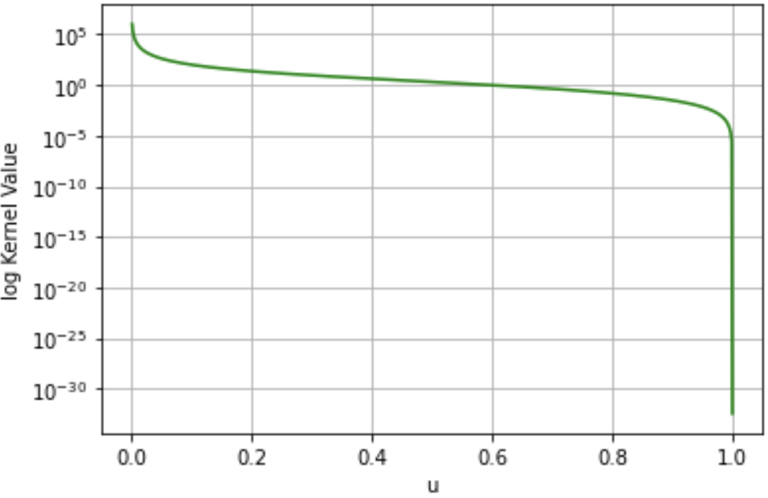
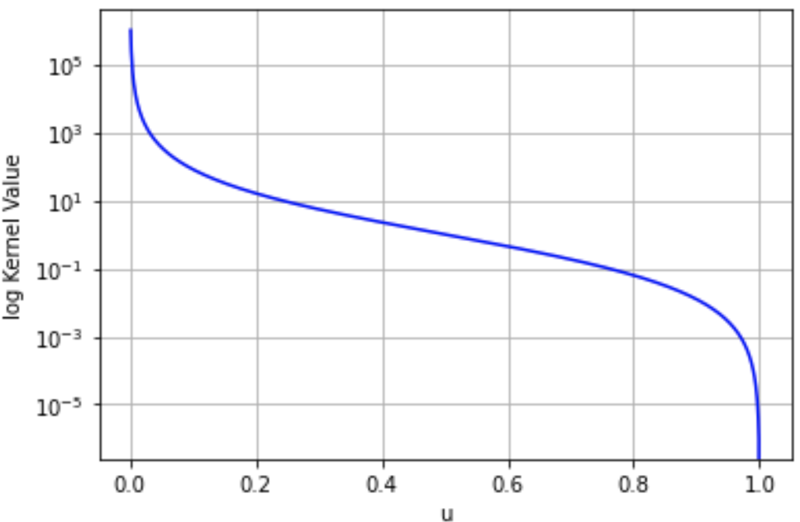
Illustration
$$K \left(u\right)={∥u∥}^{−a} \cos^{2}\left(π\frac{∥u∥}{2}\right)Ι\left\{∥u∥ ≤ 1\right\}$$
$$K (u)={∥u∥}^{−a}{\left[1−∥u∥\right]}_{+}^{2}$$
$$K (u)={∥u∥}^{−a}Ι\{∥u∥ ≤ 1\}$$

Slide 13
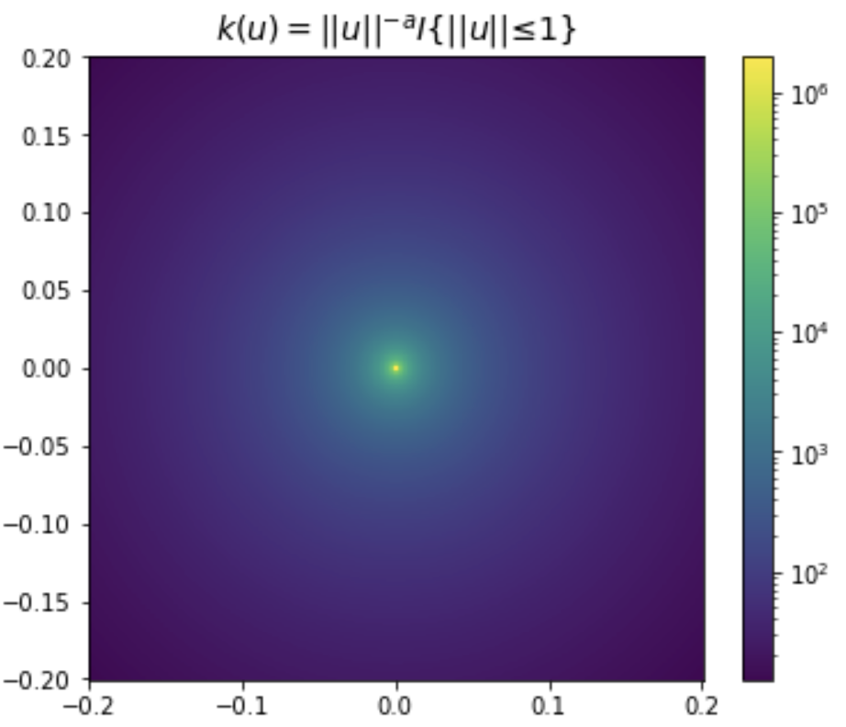
Illustration

Slide 14
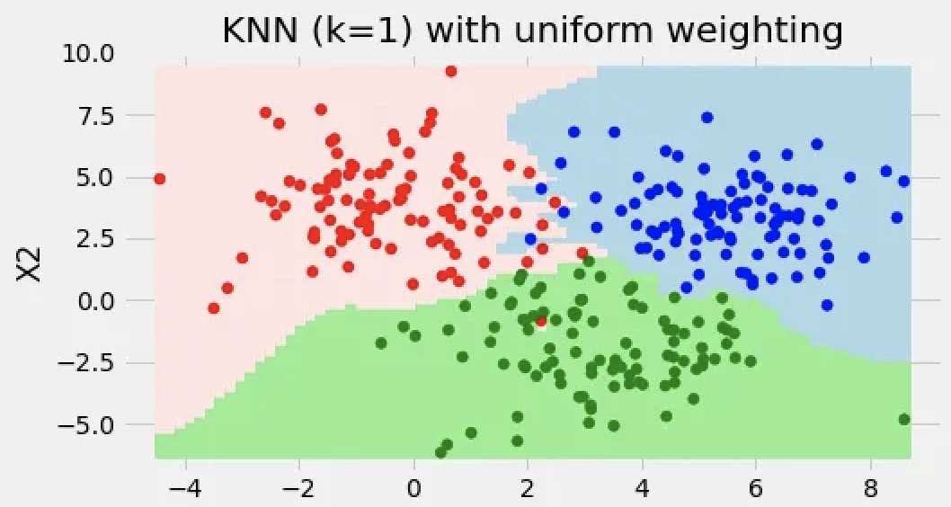
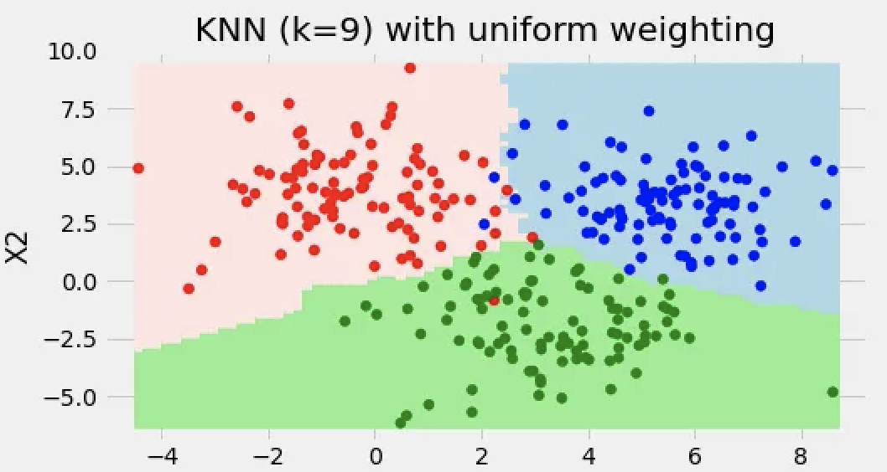
Review of Prior Work
^{[1]}
The 1-NN classifier interpolates the training data.
Consistency in k-NN classifiers requires increasing k with the sample size n, moving away from pure interpolation.
Prior research has explored singular kernels for data interpolation, noting their potential despite a lack of finite-sample guarantees.
Non-Asymptotic Rates and Suboptimality
[1] https://towardsdatascience.com/k-nearest-neighbors-k-nn-explained-8959f97a8632

Slide 15
The Nadaraya-Watson estimator for a singular kernel
We assume that:
For any $x ∈ ℝ^{d}$, the expectation $𝔼[Y |X = x]=f(x)$exists and $𝔼[ξ^{2}|X = x] ≤ σ_{ξ}^{2} < ∞$, where
$ξ=Y −𝔼[Y|X]=Y −f(X)$.
The marginal density $p(·)$of $X$ exists and satisfies $0 < p_{min} ≤ p(x) ≤p_{max}$for all $x$ on its support.
$f_{n}(x)\left\{\begin{aligned}Y_{i} if x=X_{i} for some i∈\left[n\right], \\ 0 if\sum_{i=1}^{n}{K\left(\frac{x−X_{i}}{h}\right)}=0, \\ \frac{\sum_{i=1}^{n}{Y_{i}K\left(\frac{x−X_{i}}{h}\right)}}{\sum_{i=1}^{n}{K\left(\frac{x−X_{i}}{h}\right)}} otherwise.\end{aligned}\right.$

Slide 16
Why Perfect Fit Doesn't Mean Overfit
Theorem 1:
Assume that $f ∈ Σ(β, L_{f} )$for $β ∈ (0, 1]$, $L_{f}>0$. Let $0<a<d/2$. Then for any fixed $x_{0} ∈ℝ^{d}$in the support of p, the estimator with bandwidth $h=n^{\frac{−1}{2β+d}}$ satisfies
$$𝔼\left[{\left(f_{n}\left(x_{0}\right)−f \left(x_{0}\right)\right)}^{2} \right]≤Cn^{\frac{− 2 β}{2 β +d}}$$
where $C > 0$ is a constant that does not depend on n.

Slide 17
Why Perfect Fit Doesn't Mean Overfit
Theorem 2:
Assume that $f ∈ Σ(β, L_{f} )$for $β ∈ (1, 2]$, $L_{f}>0$. Let $0<a<d/2$. Assume in addition that, for all x, y in the support of p, we have $\left|p\left(x\right)−p(y)\right|≤L_{p}{∥x−y∥}^{β−1}$, $L_{p}>0$.Then for any fixed $x_{0} ∈ℝ^{d} \text{such} \text{that} \text{the} \text{Euclidean} \text{ball} \text{of} \text{radius} \text{h} \text{centered} \text{at}{ x}_{0}$ is contained in the support of p, the estimator with bandwidth $h=n^{\frac{−1}{2β+d}}$ satisfies
$$𝔼\left[{\left(f_{n}\left(x_{0}\right)−f \left(x_{0}\right)\right)}^{2} \right]≤Cn^{\frac{− 2 β}{2 β +d}}$$
where $C > 0$ is a constant that does not depend on n.

Slide 18
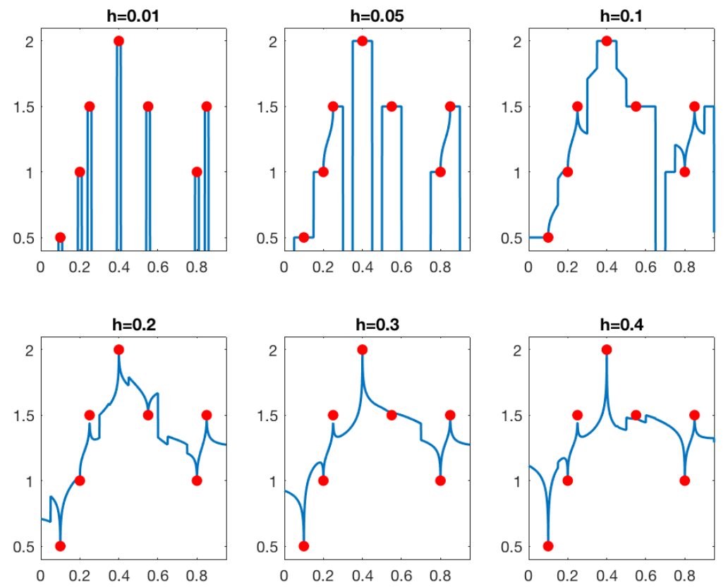

Slide 19
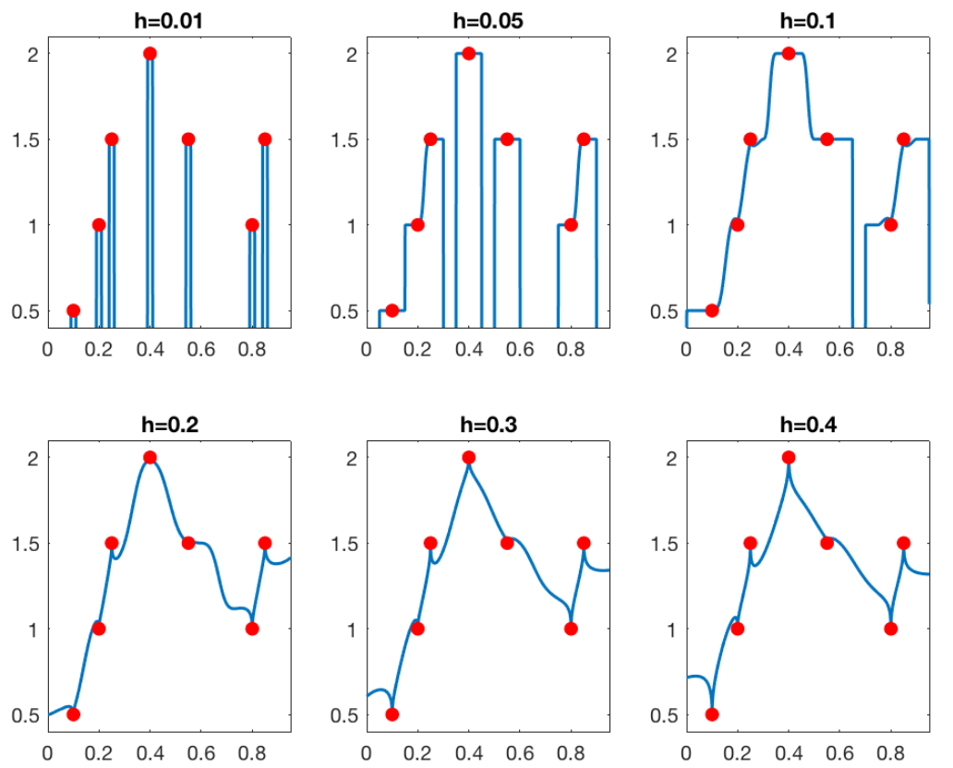

Slide 20
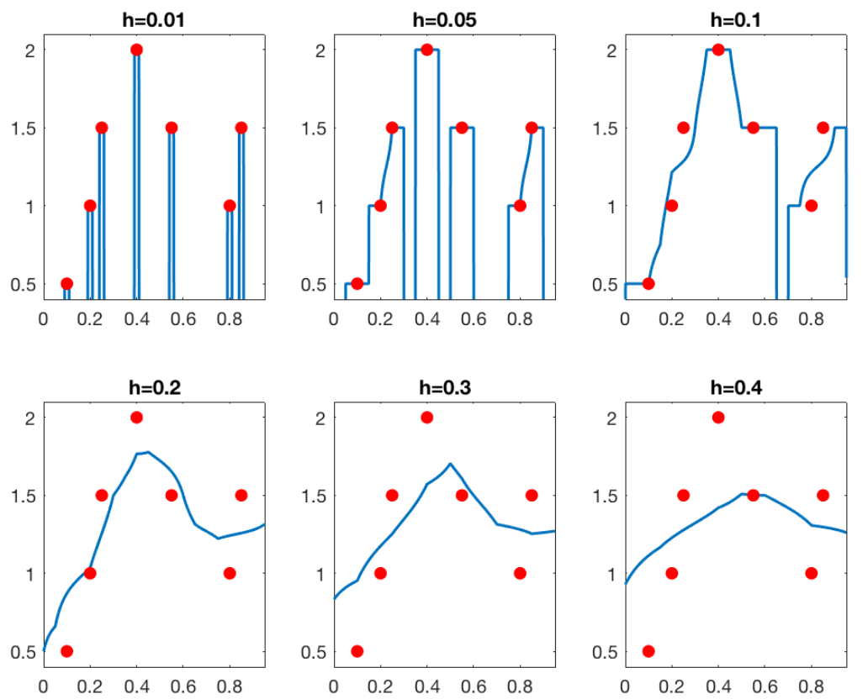
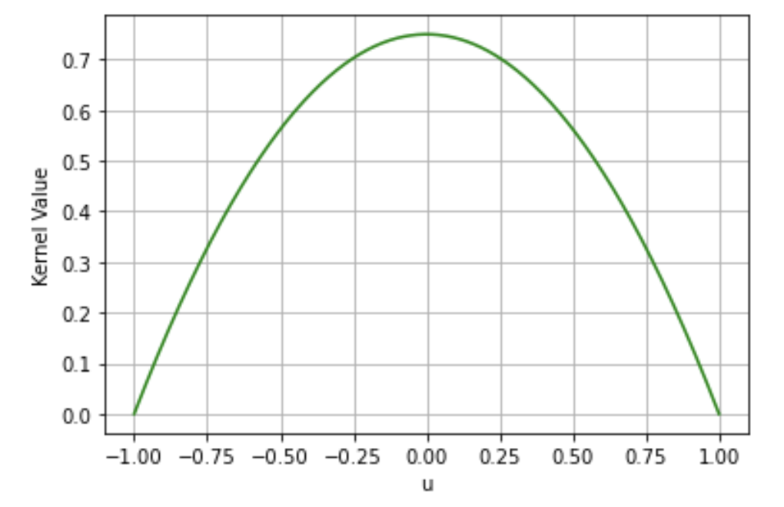

Slide 21
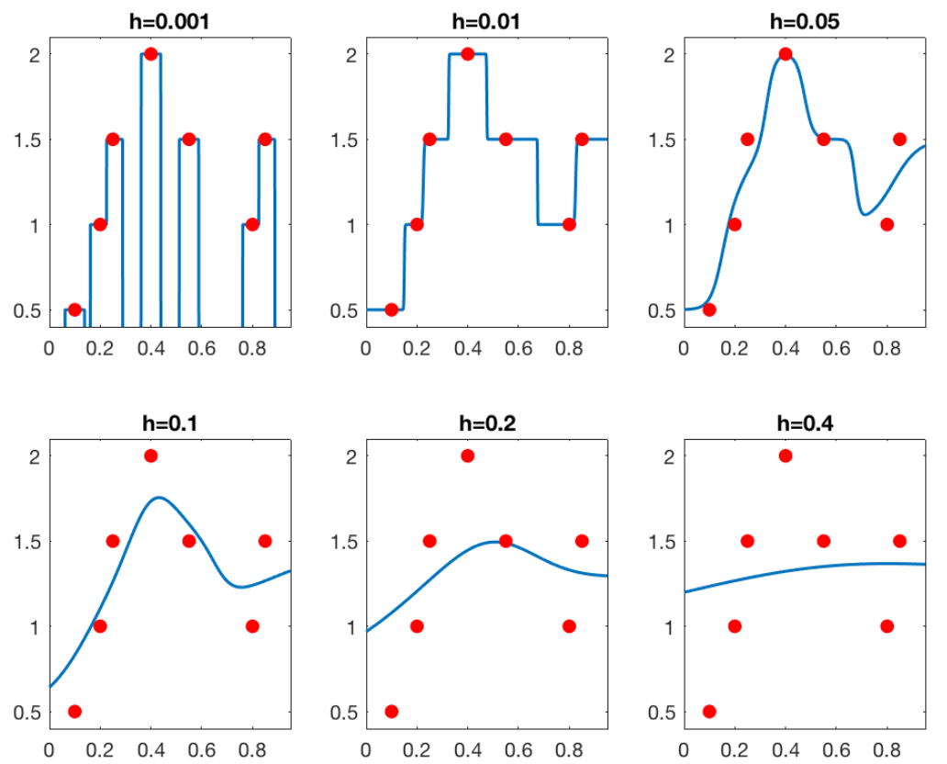
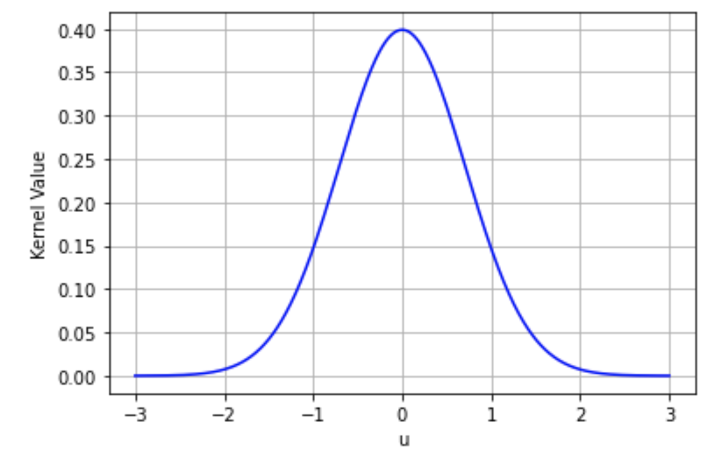

Slide 22
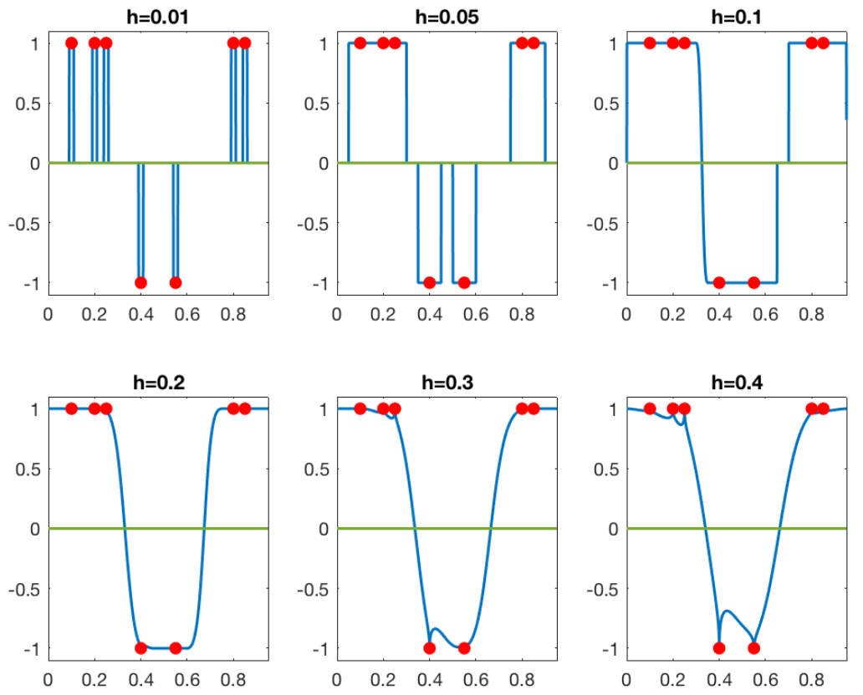

Slide 23
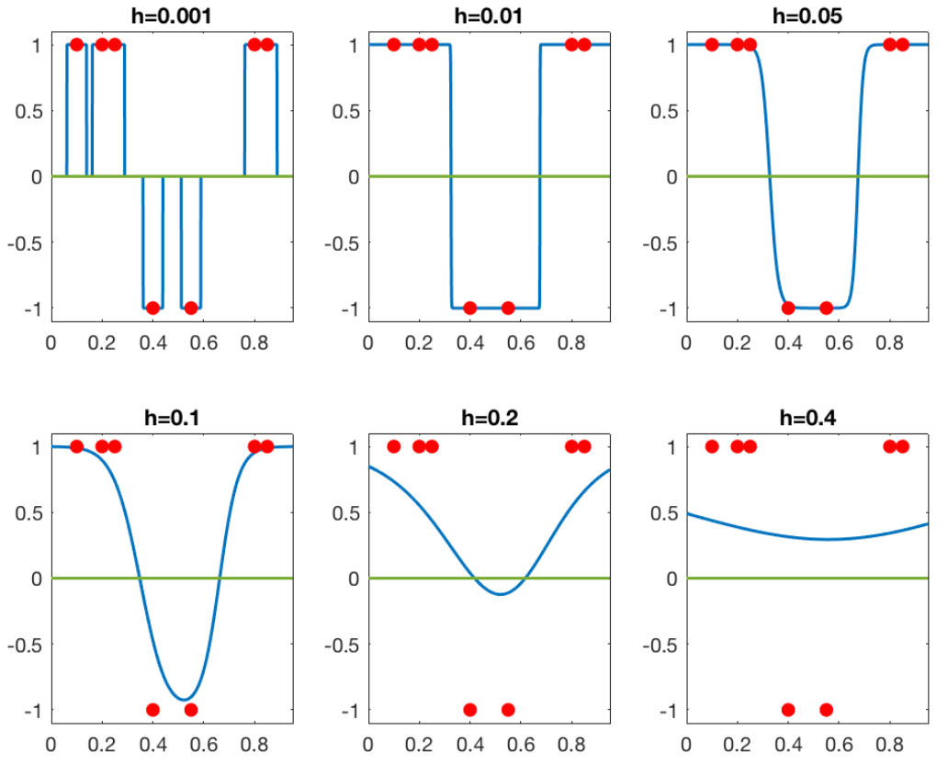

Slide 24
Proof outline
Consider the event $ε=\left\{\sum_{i=1}^{n}{k_{h}(X_{i})≠0}\right\}=\left\{∃i=1, …, n: \left\|X_{i}\right\|≤h\right\}$, where $k_{h}\left(x\right)=k\left(\frac{x}{h}\right)$.
Bias Variance decomposition: $𝔼[{\left(f_{n}(0) − f(0)\right)}^{2}]$ $≤𝔼\left[{\left(f_{n}\left(0\right)−{𝔼_{Y}f}_{n}\left(0\right)+𝔼_{Y}\bar{f_{n}}\left(0\right)−f\left(0\right)\right)}^{2}I\left\{ε\right\}\right]+M_{ε}$
$=𝔼\left[{\left(f_{n}\left(0\right)−𝔼_{Y}f_{n}\left(0\right)\right)}^{2}I\left\{ε\right\}\right]$ $⟵$Variance
$+𝔼\left[{\left(𝔼_{Y}f_{n}\left(0\right)−f(0)\right)}^{2}I\left\{ε\right\}\right]$ $⟵$ Bias
$+M_{ε}$

Slide 25
Proof outline
Bounding the variance: $σ^{2}(0)≤\frac{{σ_{ξ}}^{2}}{nh^{d}}$
Bounding the bias: $b^{2}(0)≤L_{f}^{2}h^{2β}$
The theorem follows by balancing $n exp\left\{−Cnh^{d}\right\}+\frac{C}{nh^{d}}+Ch^{2β}$ with $h=n^{−\frac{1}{2β+d}}$

Slide 26
Reflection and critic
Rigorous viewpoint to the understanding of overfitting.
The function class may not hold in every scenario.
Lack of examples.
Exploring higher dimensions.
Extending these results to other nonparametric estimators

Slide 27
Follow up papers
Surprises in high-dimensional ridgeless least squares interpolation. Hastie, T., Montanari, A., Rosset, S., & Tibshirani, R. J. (2022).
Benign overfitting in linear regression Bartlett, P. L., Long, P. M., Lugosi, G., & Tsigler, A. (2020).
Fit without fear: remarkable mathematical phenomena of deep learning through the prism of interpolation. Belkin, M. (2021)
Reconciling modern machine-learning practice and the classical bias–variance trade-off. Belkin, M., Hsu, D., Ma, S., & Mandal, S. (2019)

Slide 28
Any questions?
Omar Mezghani
20. March 2024

Slide 29
Proof outline
The bias term is
$$b^{2}\left(0\right)=𝔼\left[{\left(𝔼_{Y}f_{n}\left(0\right)−f(0)\right)}^{2}I\left\{ε\right\}\right]=𝔼\left[{\left(\frac{\sum_{i=1}^{n}{\left(f(X_{i}\right)−f(0))}k_{h}(X_{i})}{\sum_{i=1}^{n}{k_{h}(X_{i})}}\right)}^{2}I\left\{ε\right\}\right]$$

Slide 30
Proof outline
It holds that $𝔼_{Y}f_{n}\left(0\right)=\frac{\sum_{i=1}^{n}{f(X_{i})}k_{h}(X_{i})}{\sum_{i=1}^{n}{k_{h}(X_{i})}}$
The variance term is
$σ^{2}\left(0\right)= 𝔼\left[{\left(f_{n}\left(0\right)−𝔼_{Y}f_{n}\left(0\right)\right)}^{2}I\left\{ε\right\}\right]=𝔼\left[{\left(\frac{\sum_{i=1}^{n}{ξ_{i}}k_{h}(X_{i})}{\sum_{i=1}^{n}{k_{h}(X_{i})}}\right)}^{2}I\left\{ε\right\}\right]≤σ_{ξ}σ_{X}$,
Where $ξ_{i} = Y_{i} − f\left(X_{i}\right) and σ_{X}=n𝔼\left[\frac{k_{h}^{2}(X_{1})}{{\left(\sum_{i=1}^{n}{k_{h}(X_{i})}\right)}^{2}}I\left\{ε\right\}\right]$

